Slide 1

S&P 500: Economic Historical & Technical Analysis
Reporter: Junshuo Liu

Slide 2
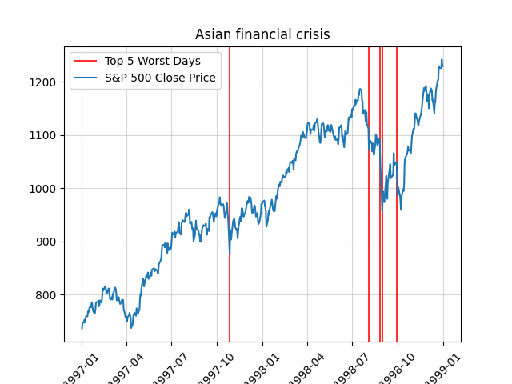
Asian financial crisis (1997-1998)
The graph points out that there are several plummets during July to October in 1998.
I treat the worst days as the periods when crisis happened

Slide 3
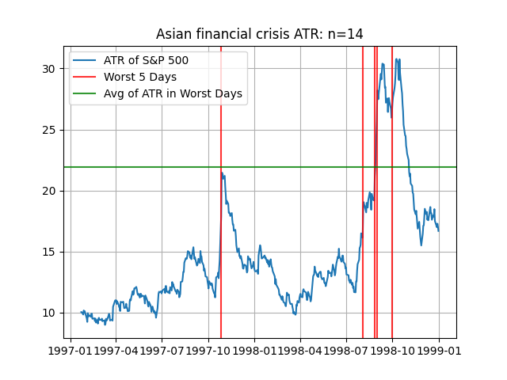
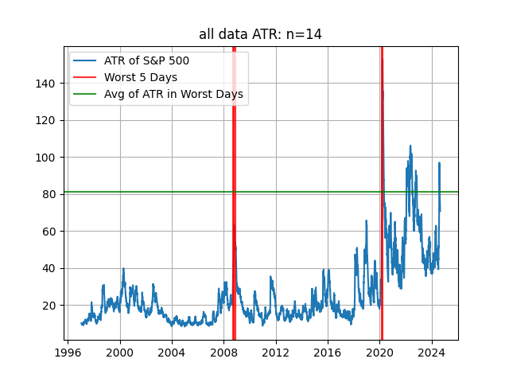
ATR - Asian Financial Crisis
Based on the data during 1997-1998, I find the fluctuations during the Asian Financial Crisis are much smaller in overview from 1996 - 2024. But the fluctuations that are nearby the crisis are much more lower.

Slide 4
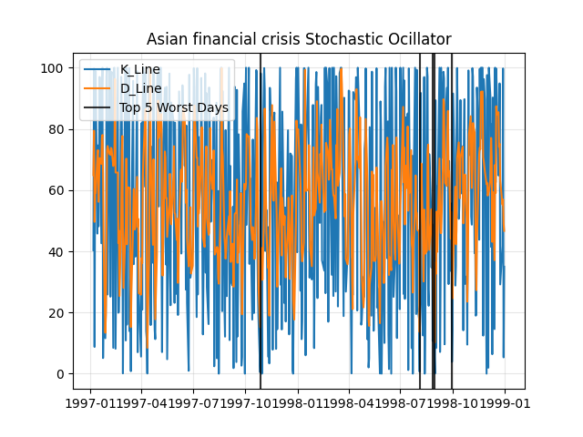
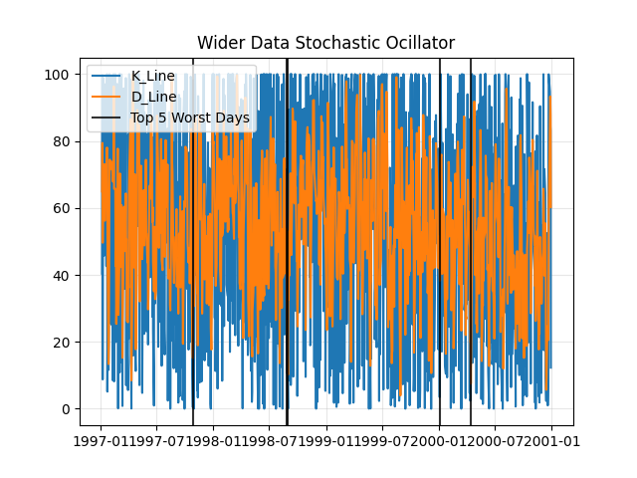
SC - Asian Financial Crisis

Slide 5
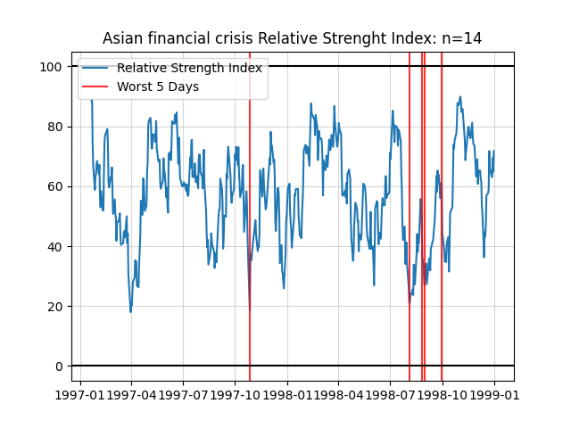
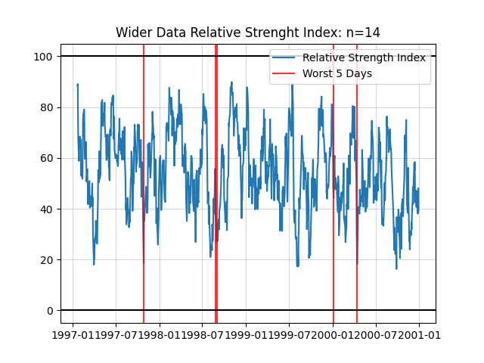
RSI - Asian Financial Crisis
By comparing these two graphs, I observe that the RSI remained in an oversold condition during the crisis, and the downside range after the crisis tends to contract.

Slide 6
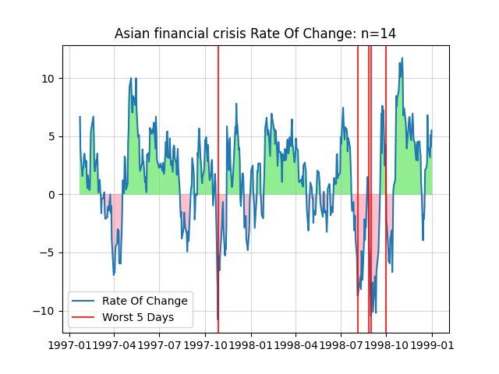
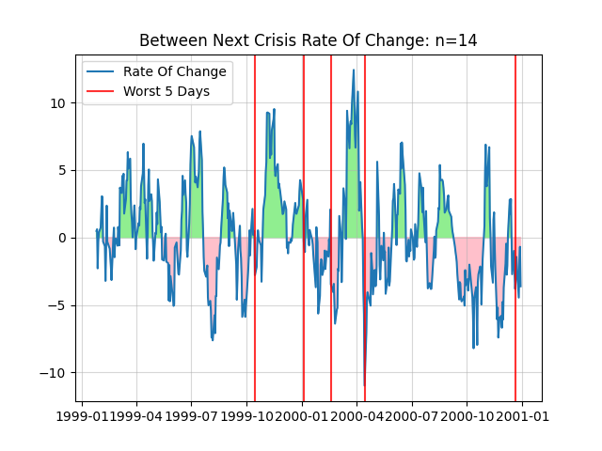
ROC - Asian Financial Crisis
By comparing these two graph, I notice that the ROC is quite low before & after the crisis

Slide 7
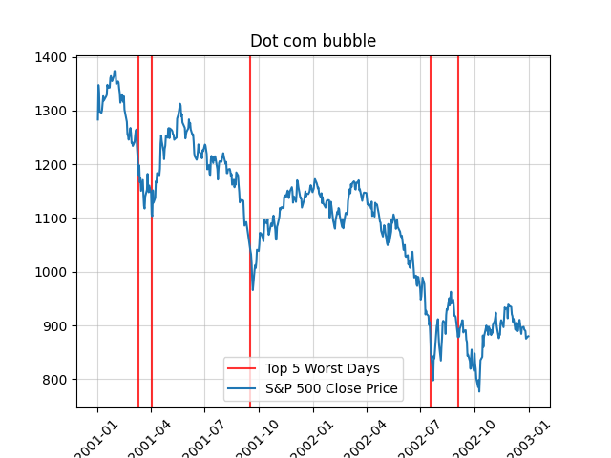
Dot Com Bubble (2001-2002)
The top 5 worst days are in around April and September in 2001, and Agust and September in 2002

Slide 8
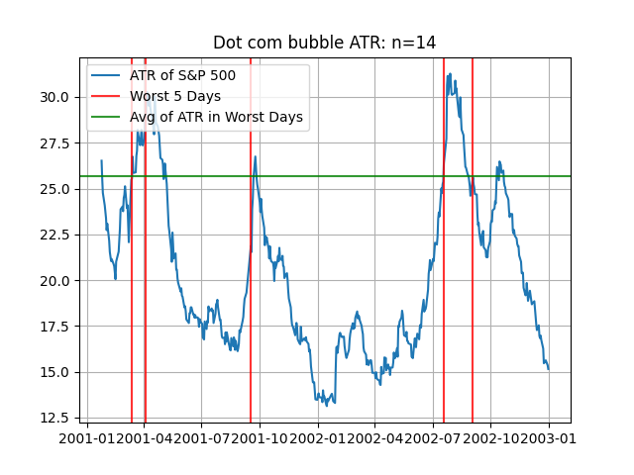
ATR - Dot Com Bubble
The crisis caused significant price fluctuations, though these were relatively smaller compared to other crises. After the Dot Com Bubble, the fluctuations gradually subsided.

Slide 9
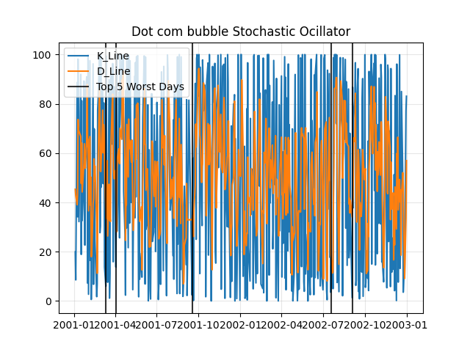
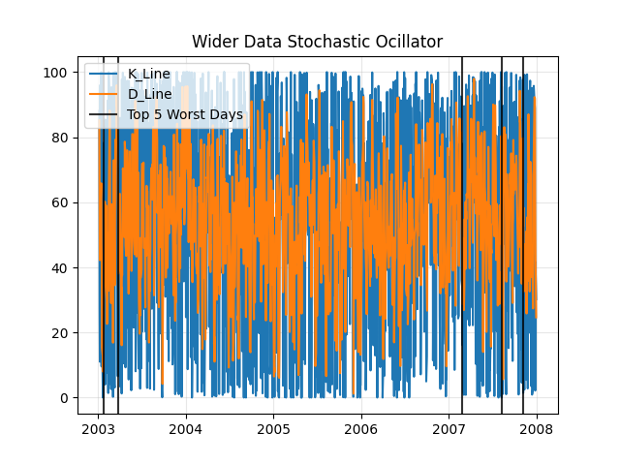
SC - Dot Com Bubble

Slide 10
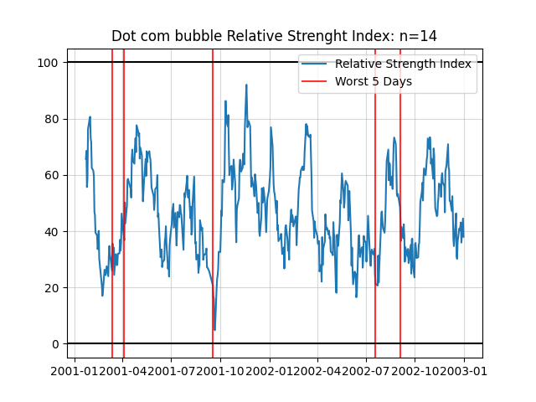
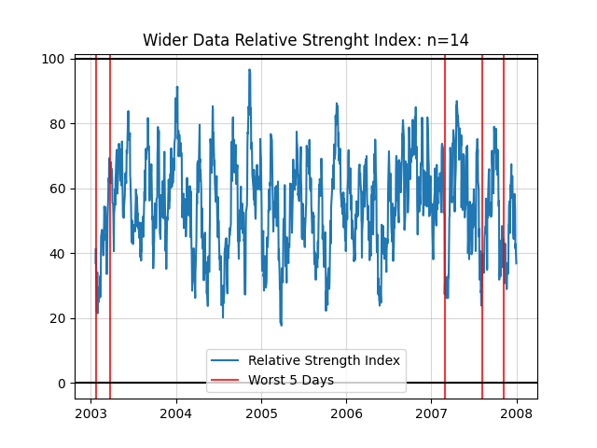
RSI - Dot Com Bubble
By comparing these two graphs, I observe that the downside range tends to shrink after each worst day, eventually forming a descending channel.

Slide 11
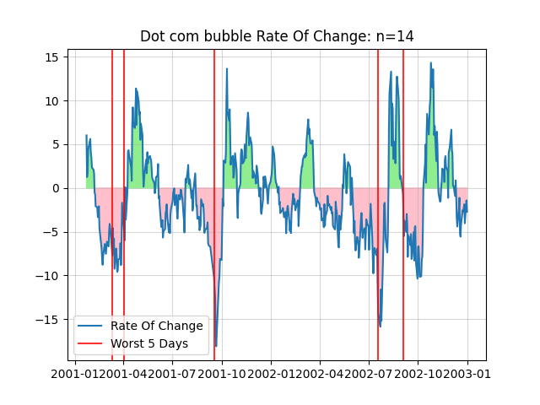
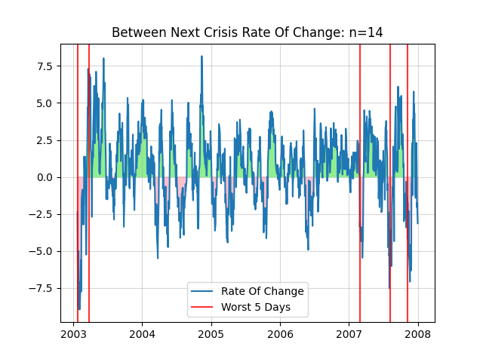
ROC - Dot Com Bubble
the ROC after the crisis is much smaller than that during the crisis

Slide 12
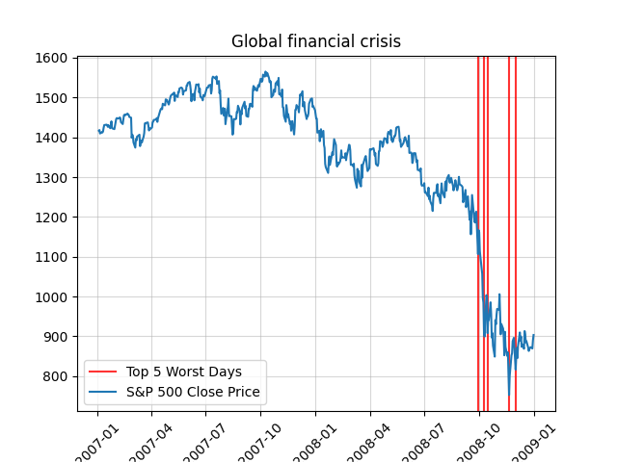
Global Financial Crisis (2007-2008)
Bankruption of Lehman Brother

Slide 13
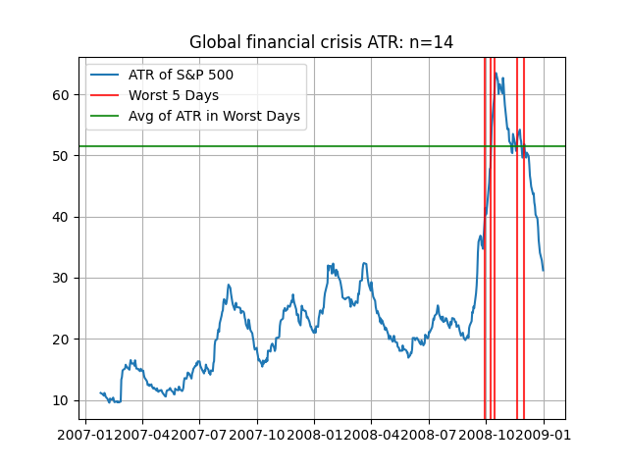
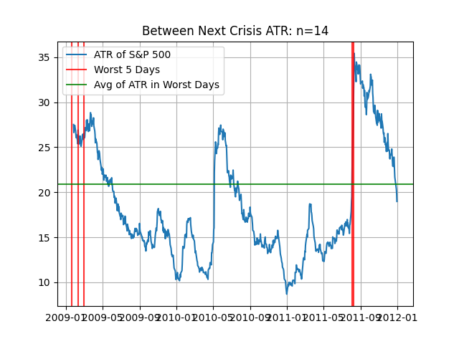
ATR - Global Financial Crisis
These two graphs show a significant subsidence in price movement both before and after the crisis.

Slide 14
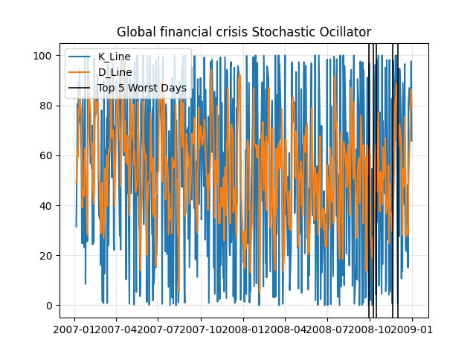
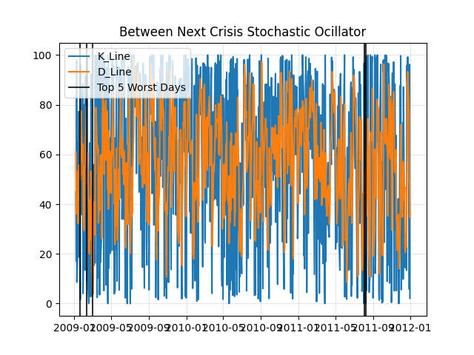
SC - Global Financial Crisis

Slide 15
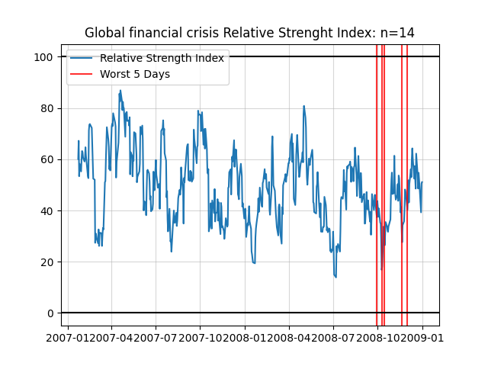
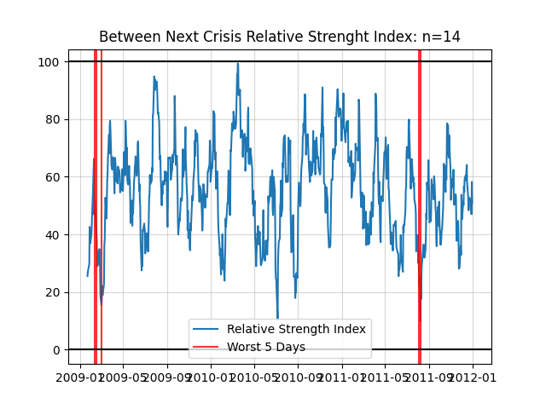
RSI - Global Financial Crisis
Based on the comparison, I found that the RSI tends to oscillate more in the upper range in the post-crisis market.

Slide 16
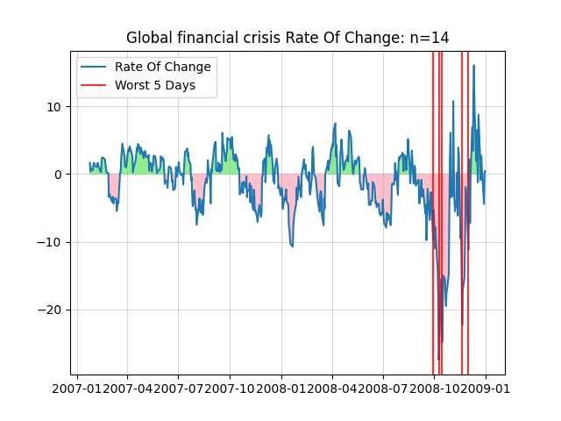
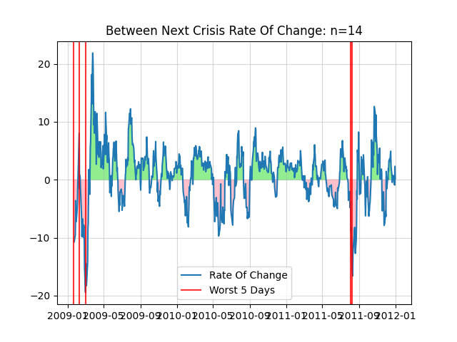
ROC - Global Financial Crisis
the green part area seems to be greater than pink part area in the post-crisis market, compared with pre-crisis market, which means more inversters have confidence again.

Slide 17
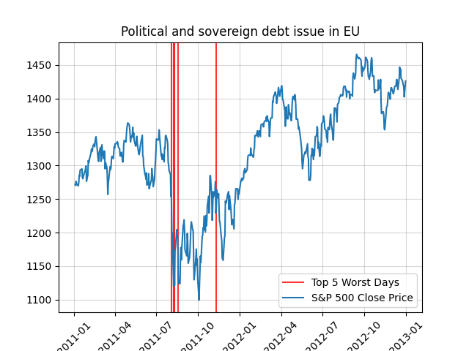
Political and Sovereign Debt Issue in EU (2011-2012)

Slide 18
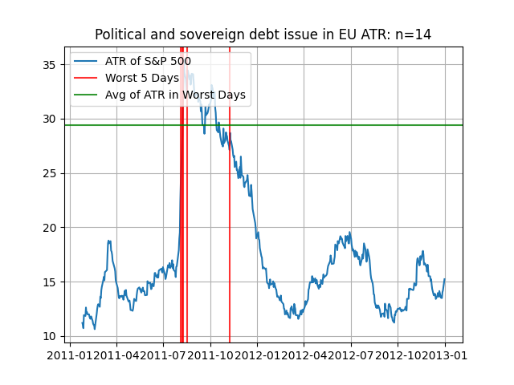
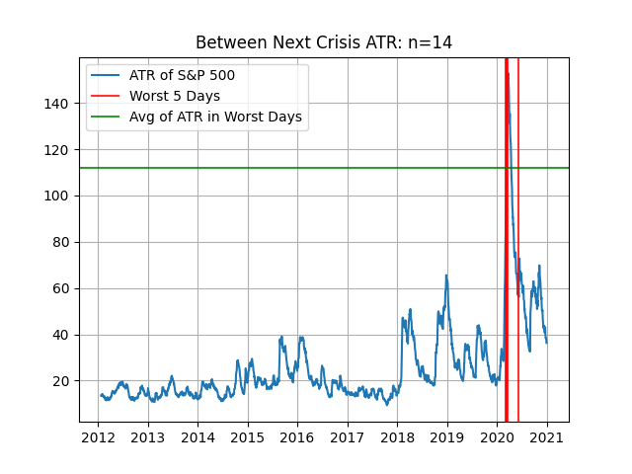
ATR - Debt Issue in EU
In 2011, the ATR rapidly rose above 30, indicating a significant increase in market volatility during the peak of the crisis. Over time, especially after the worst period of the crisis, the ATR clearly declined. For a period after the crisis, the ATR was significantly lower than during the crisis, indicating a substantial reduction in market volatility. This suggests that the market calmed down after the crisis.

Slide 19
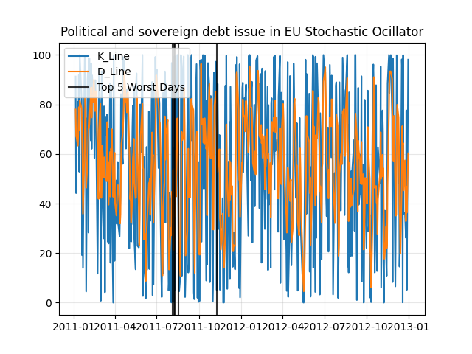
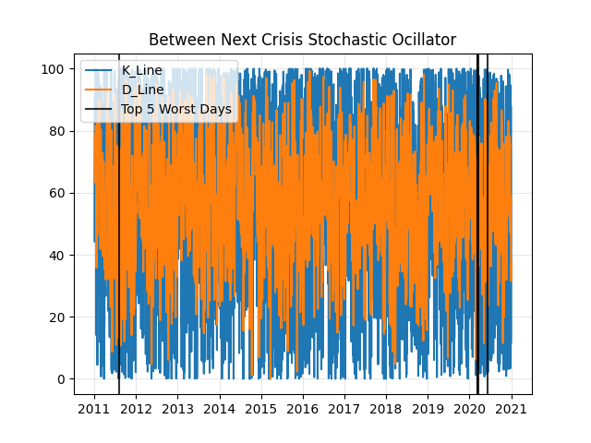
SC - Debt Issue in EU

Slide 20
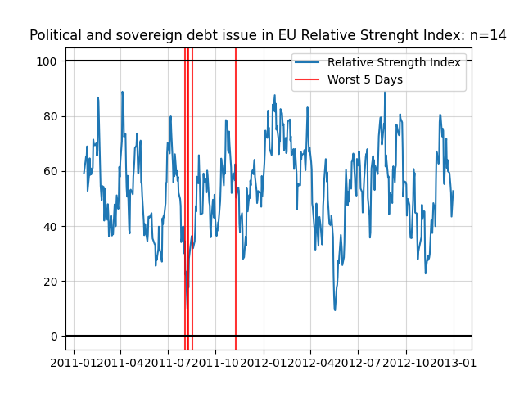
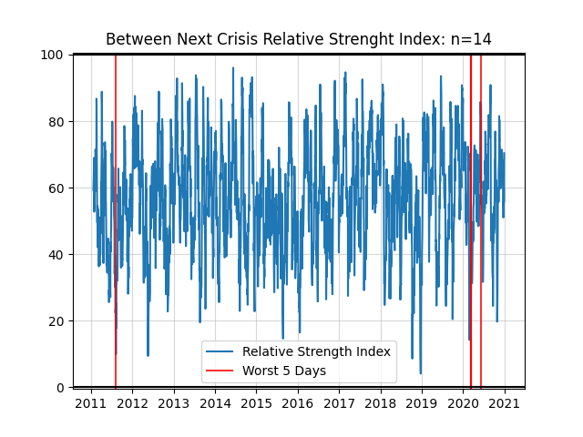
RSI - Debt Issue in EU

Slide 21
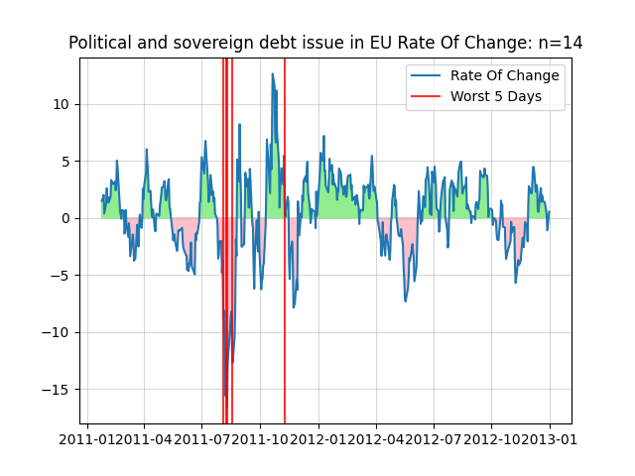
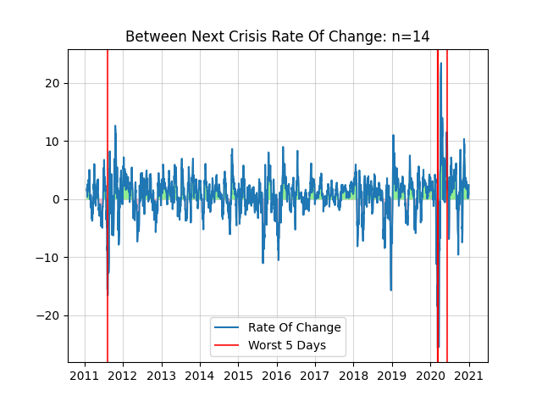
ROC - Debt Issue in EU
299 (+) vs 189 (-) 61.27%
1673 (+) vs 830 (-) 66.84%
After an economic crisis, as the market and economy gradually recover from the downturn, the prices of many assets tend to rebound, leading to more positive rates of change (ROC). This is typically seen as a signal of market recovery.​

Slide 22
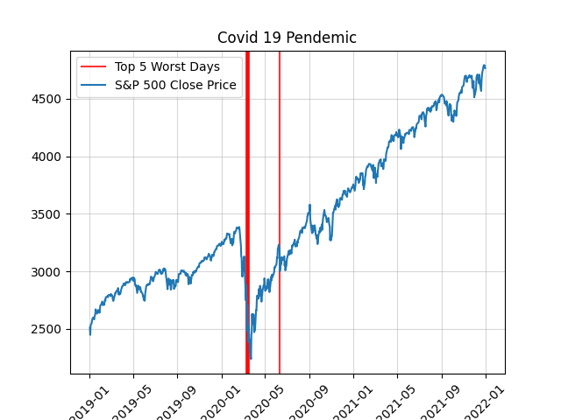
Covid-19 Pandemic (2021-2022)
Drop about 1000 USD

Slide 23
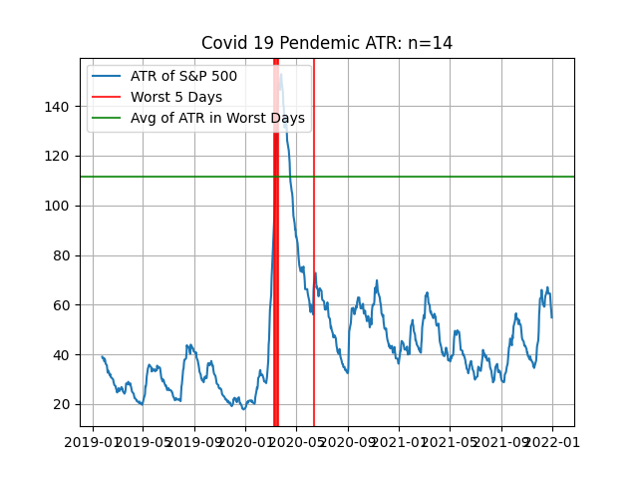
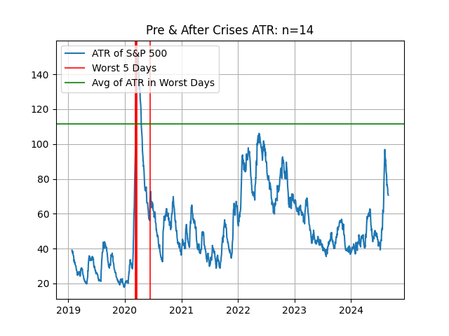
ATC - Covid-19 Pandemic
The left chart highlights the significant increase in market volatility during the worst days of the pandemic (marked by red lines), while the right chart focuses on the pre- and post-crisis ATR levels, showing how the market volatility fluctuated during recovery periods. The ATR spike during the pandemic is indicative of higher market uncertainty, with volatility decreasing post-crisis but still experiencing fluctuations.

Slide 24
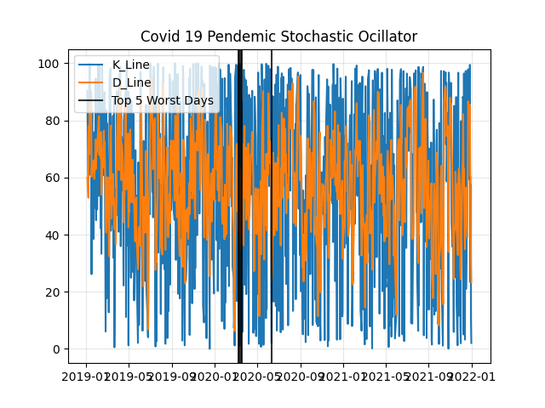
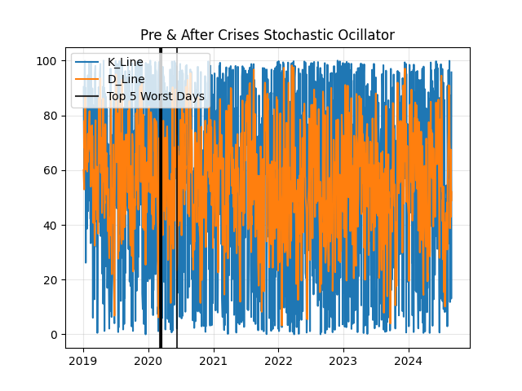
SC - Covid-19 Pandemic

Slide 25
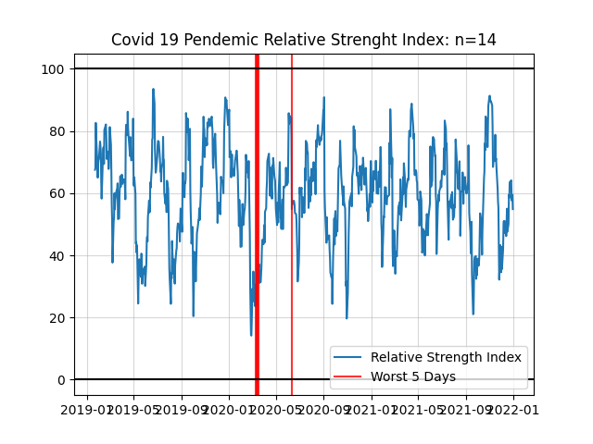
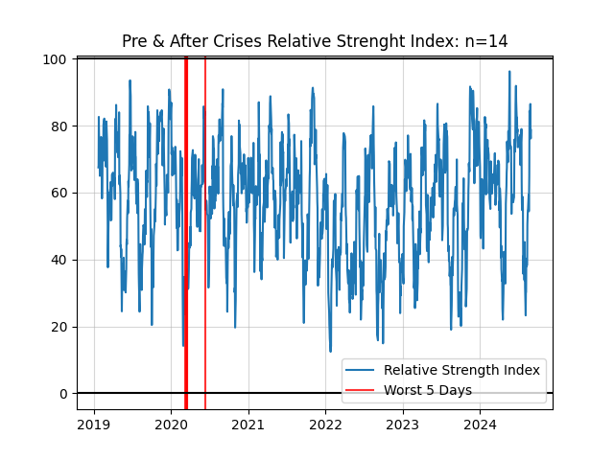
RSI - Covid-19 Pandemic
The RSI experienced significant swings, particularly during the early phase of the pandemic, indicating intense market volatility. Similar to the left chart, the RSI later stabilized, returning to more typical levels of fluctuation..

Slide 26
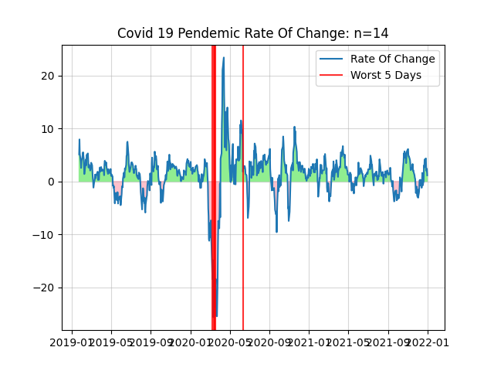
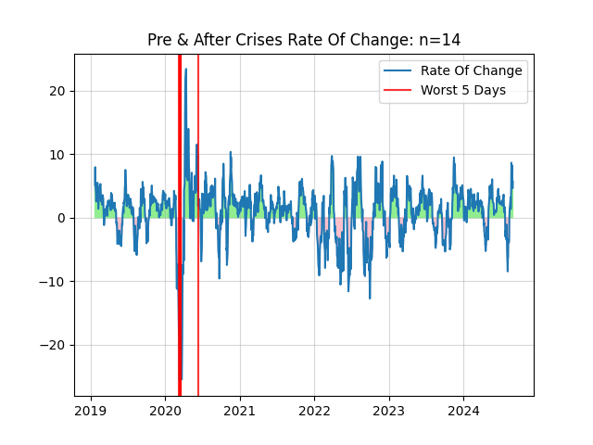
ROC - Covid-19 Pandemic
After a plummet there was a suddern increase following. The post-market tends to lean to the long side. During the 2022 to 2023, fluctuation increases again.

Slide 27
Thanks

